Slide 1




Photo by creepyed - Creative Commons Attribution-NonCommercial-ShareAlike License https://www.flickr.com/photos/32842313@N00
Created with Haiku Deck
Notes:
Presenter Notes GoogleDoc:
https://docs.google.com/document/d/1-4VIzuXszAhBRyokkVDLchymIyQRn8c9323dEdJScbY/edit?usp=sharing
[SLIDE]

Slide 2
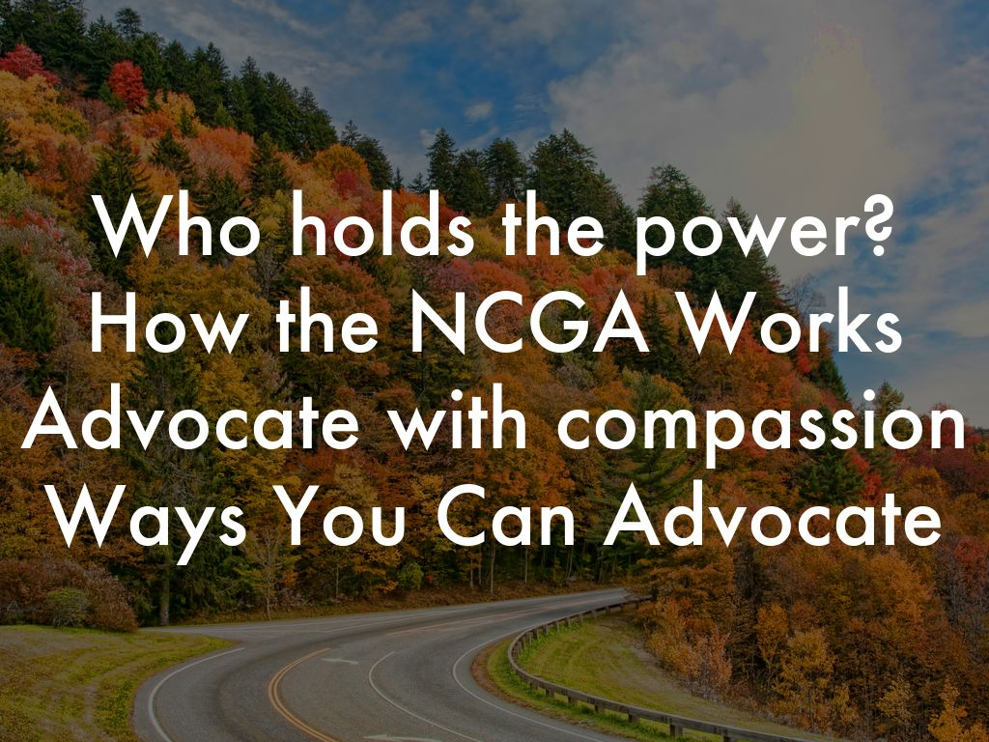
Photo by Timothy Wildey - Creative Commons Attribution-NonCommercial License https://www.flickr.com/photos/36662615@N05
Created with Haiku Deck

Slide 3
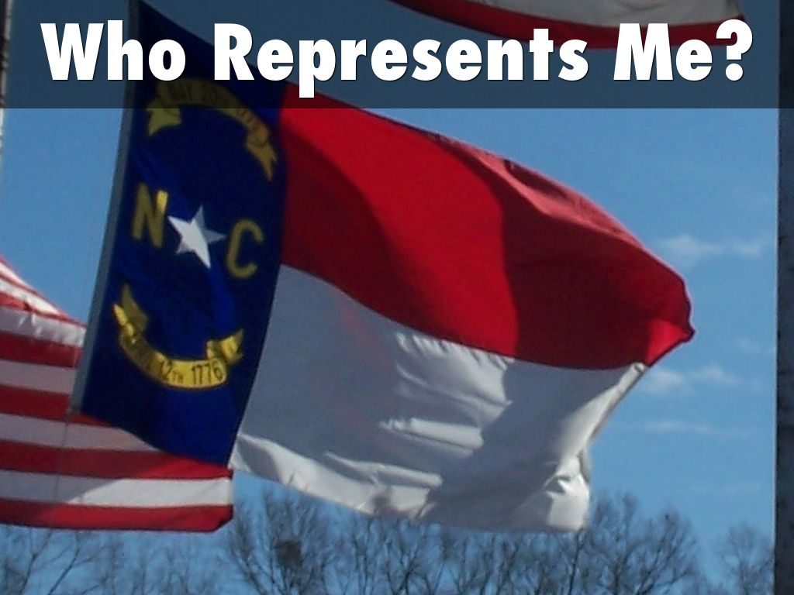
Photo by J. Stephen Conn - Creative Commons Attribution-NonCommercial License https://www.flickr.com/photos/83372564@N00
Created with Haiku Deck

Slide 4
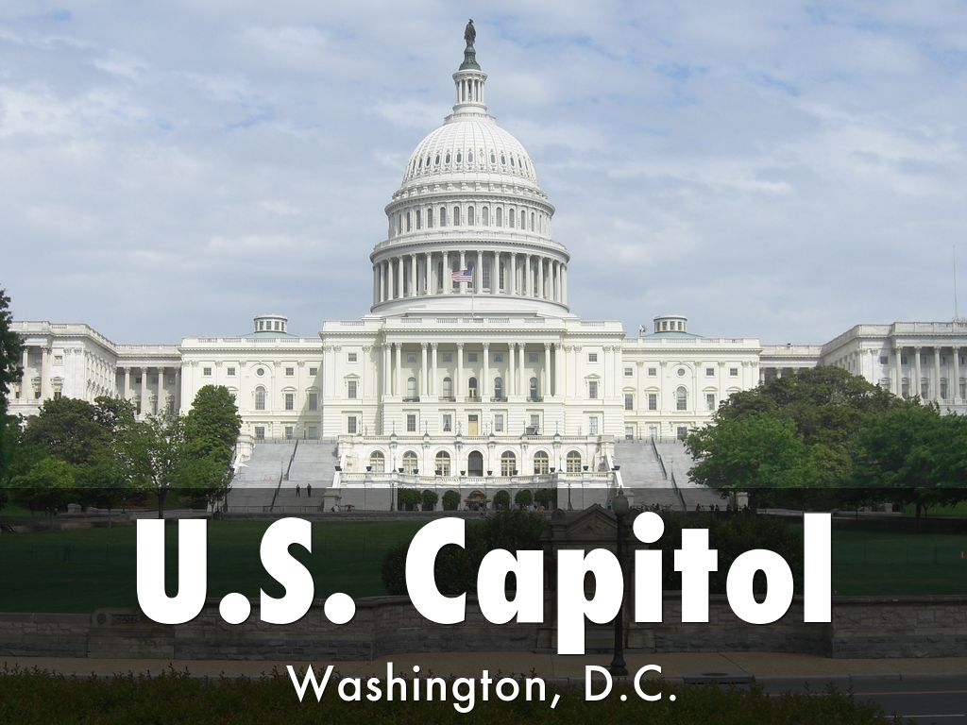
Photo by Nelo Hotsuma - Creative Commons Attribution License https://www.flickr.com/photos/63122283@N06
Created with Haiku Deck

Slide 5


Slide 6
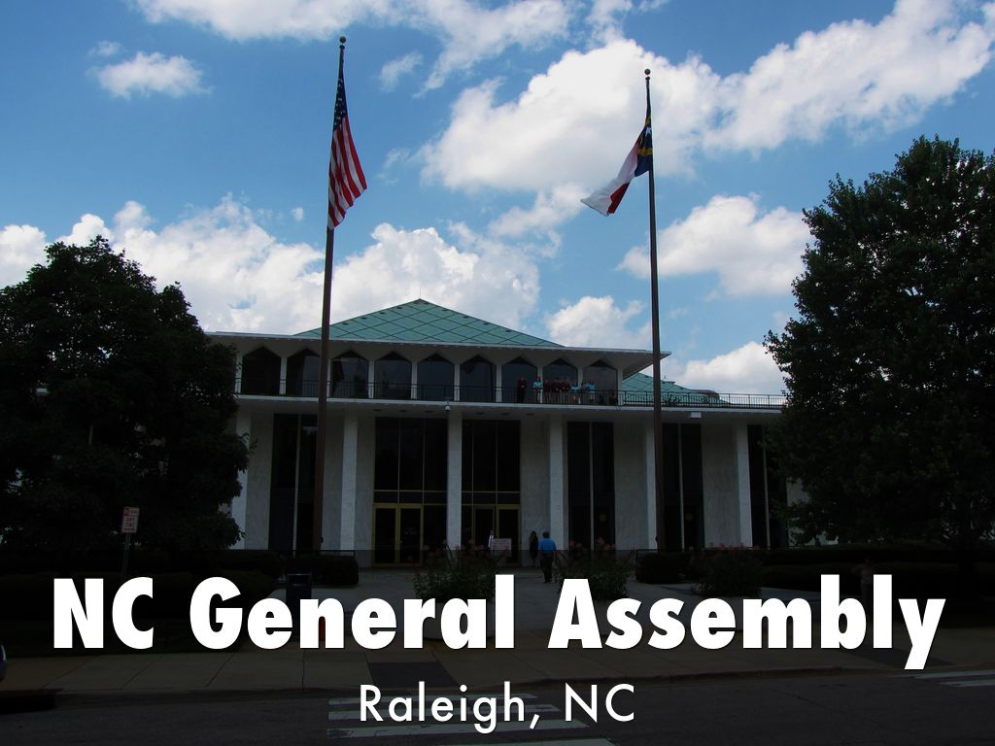
Photo by Gerry Dincher - Creative Commons Attribution-ShareAlike License https://www.flickr.com/photos/11629603@N04
Created with Haiku Deck

Slide 7
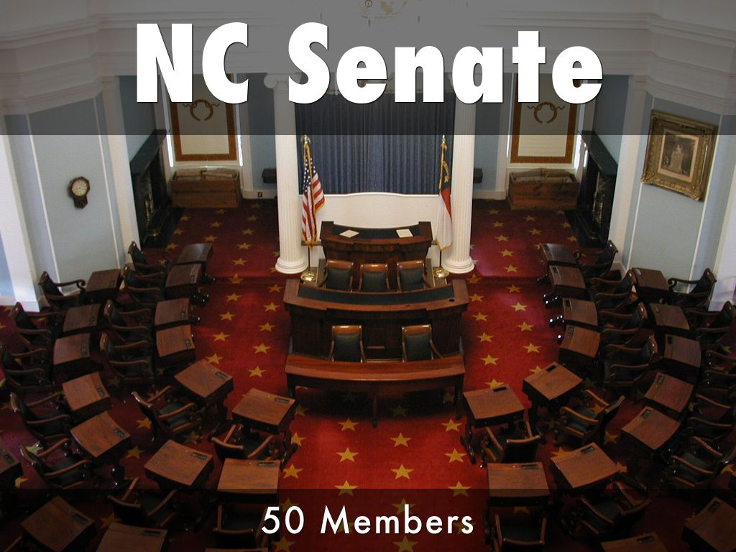
Photo by Government & Heritage Library, State Library of NC - Creative Commons Attribution License https://www.flickr.com/photos/14247749@N00
Created with Haiku Deck

Slide 8
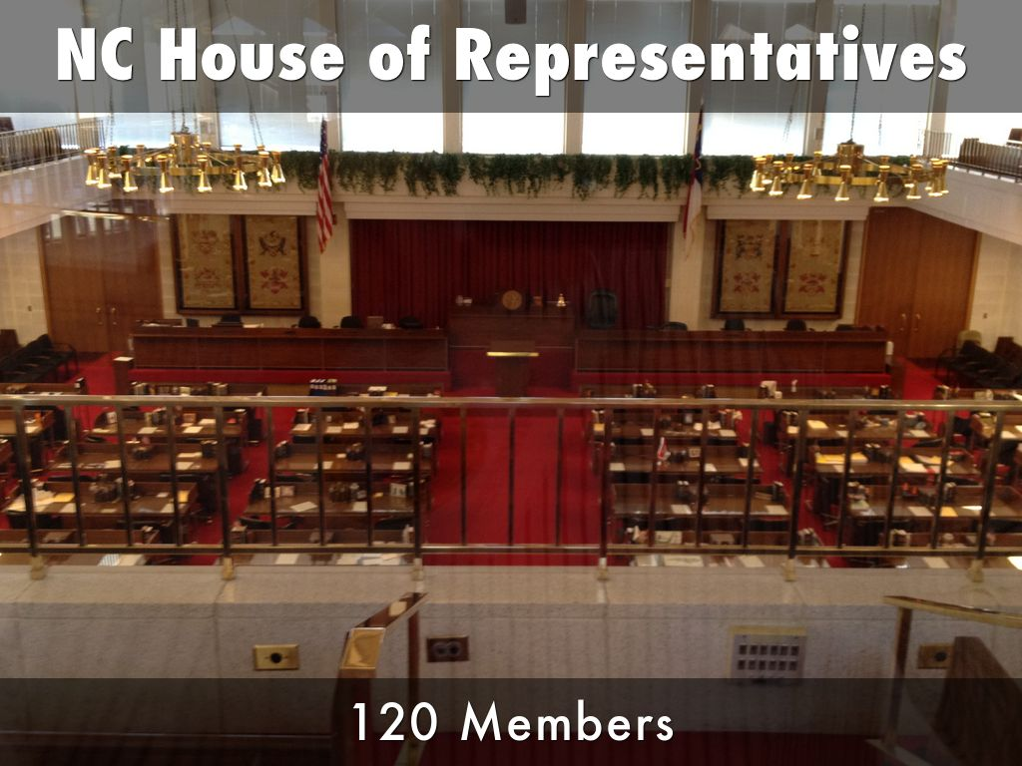
Photo by Marc Tomik - Creative Commons Attribution-NonCommercial-ShareAlike License https://www.flickr.com/photos/46074127@N02
Created with Haiku Deck

Slide 9
NC General Assembly Two Year Cycle
Long Session Recess Short Session Recess
January-August August-May May-July July-January
Odd Year (2025) (2025-2026) Even Year (2026) (2026-2027)
Substantive Bills Committee Unfinished Bills Committee
Budget Work Budget Work

Slide 10
NC General Assembly Two Year Cycle
January Feb - April May June - Aug
Convene Bill Filing Crossover Debate & Votes
Deadlines Deadline Adjourn

Slide 11
How Does A Bill Become Law?
1st Reading Committee 2nd Reading 3rd Reading
Introduced Debate Full Chamber Full Chamber
Referred to Public Testimony Debate Debate
Committee Amendments Amendments Amendments
Vote Vote Vote

Slide 12
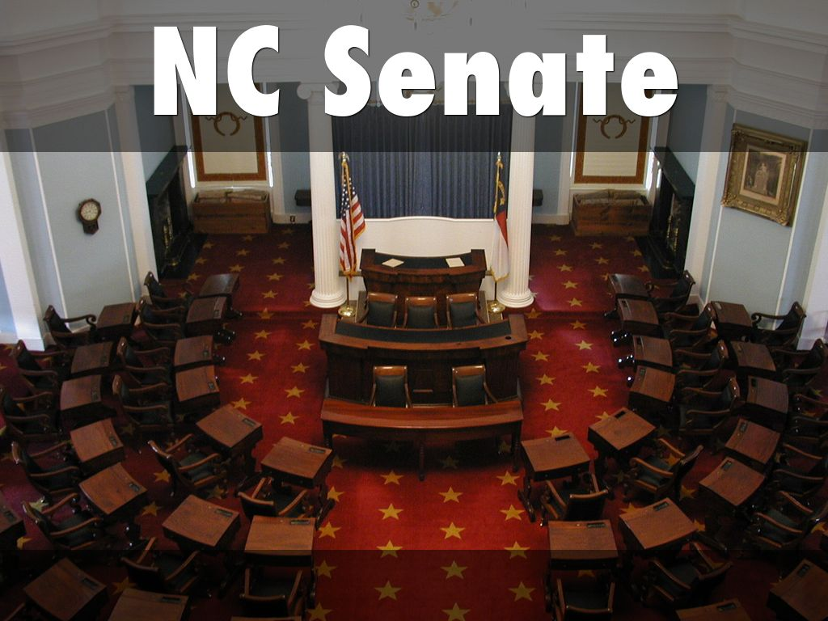
Photo by Government & Heritage Library, State Library of NC - Creative Commons Attribution License https://www.flickr.com/photos/14247749@N00
Created with Haiku Deck

Slide 13
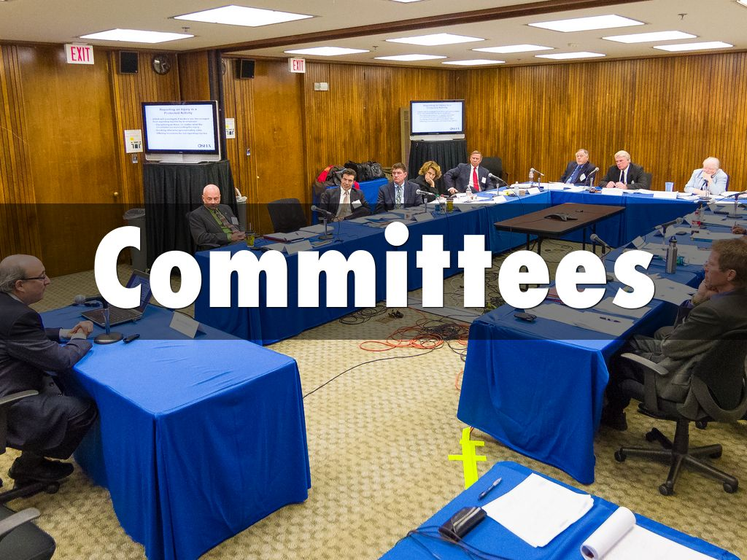
Photo by US Department of Labor - Creative Commons Attribution License https://www.flickr.com/photos/52862363@N07
Created with Haiku Deck

Slide 14
How Does A Bill Become Law?
1st Reading Committee 2nd Reading 3rd Reading
Introduced Debate Full Chamber Full Chamber
Referred to Public Testimony Debate Debate
Committee Amendments Amendments Amendments
Vote Vote Vote

Slide 15
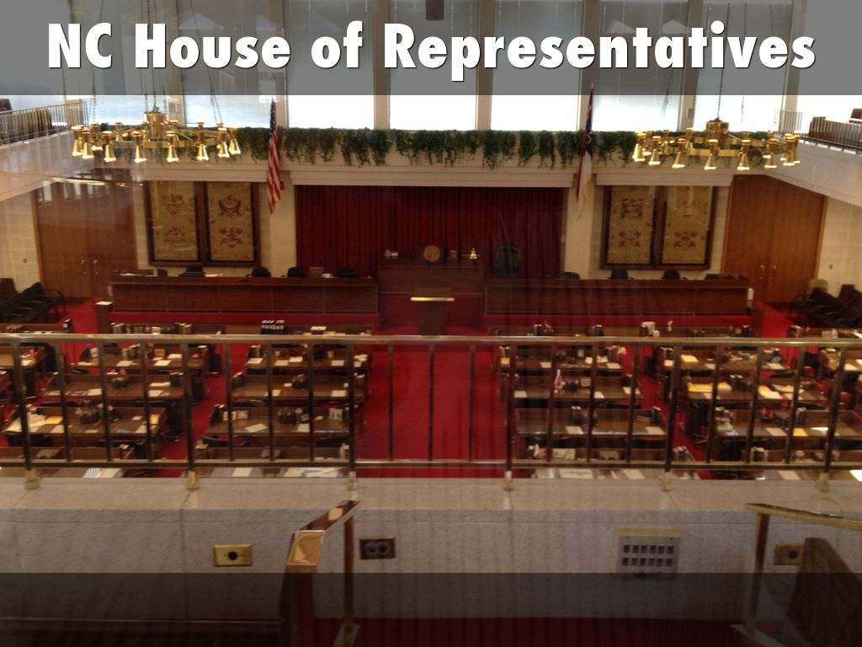
Photo by Marc Tomik - Creative Commons Attribution-NonCommercial-ShareAlike License https://www.flickr.com/photos/46074127@N02
Created with Haiku Deck

Slide 16
How Does A Bill Become Law?
1st Reading Committee 2nd Reading 3rd Reading
Introduced Debate Full Chamber Full Chamber
Referred to Public Testimony Debate Debate
Committee Amendments Amendments Amendments
Vote Vote Vote

Slide 17
Long Session
January Feb - April May June - Aug
Convene Bill Filing Crossover Debate & Votes
Deadlines Deadline Adjourn

Slide 18
What Goes On Between Sessions?
District Work Committee Mtgs Elections
Constituent Mtgs Standing NCGA every 2 yr
Return to Work Ad Hoc Governor
Research every 4 yr

Slide 19
NC General Assembly Two Year Cycle
Long Session Recess Short Session Recess
January-August August-May May-July July-January
Odd Year (2025) (2025-2026) Even Year (2026) (2026-2027)
Substantive Bills Committee Unfinished Bills Committee
Budget Work Budget Work

Slide 20
Short Session
May June - July
Convene Budget
Fiscal Year Starts
July 1st

Slide 21

Photo by swanky - Creative Commons Attribution-NonCommercial-ShareAlike License https://www.flickr.com/photos/88607481@N00
Created with Haiku Deck

Slide 22

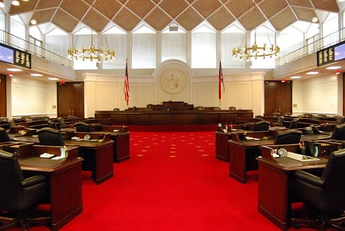
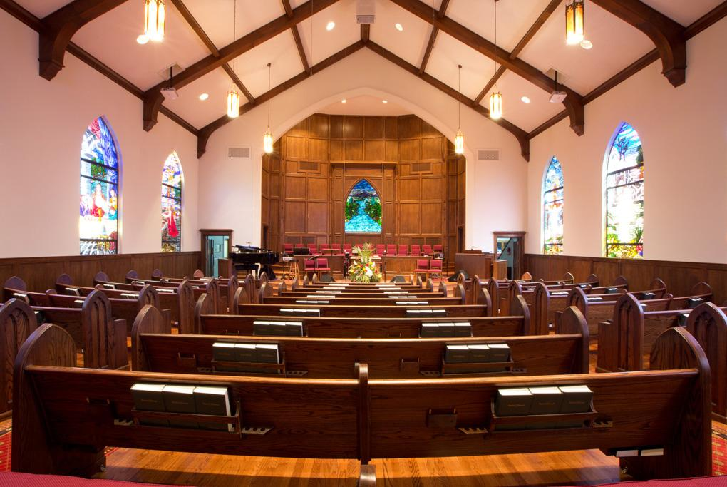
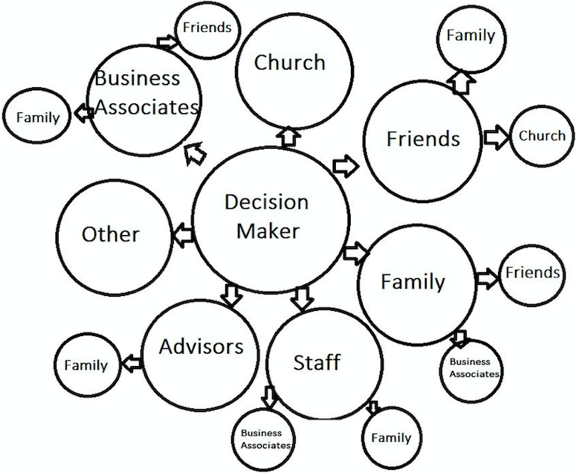

Slide 23
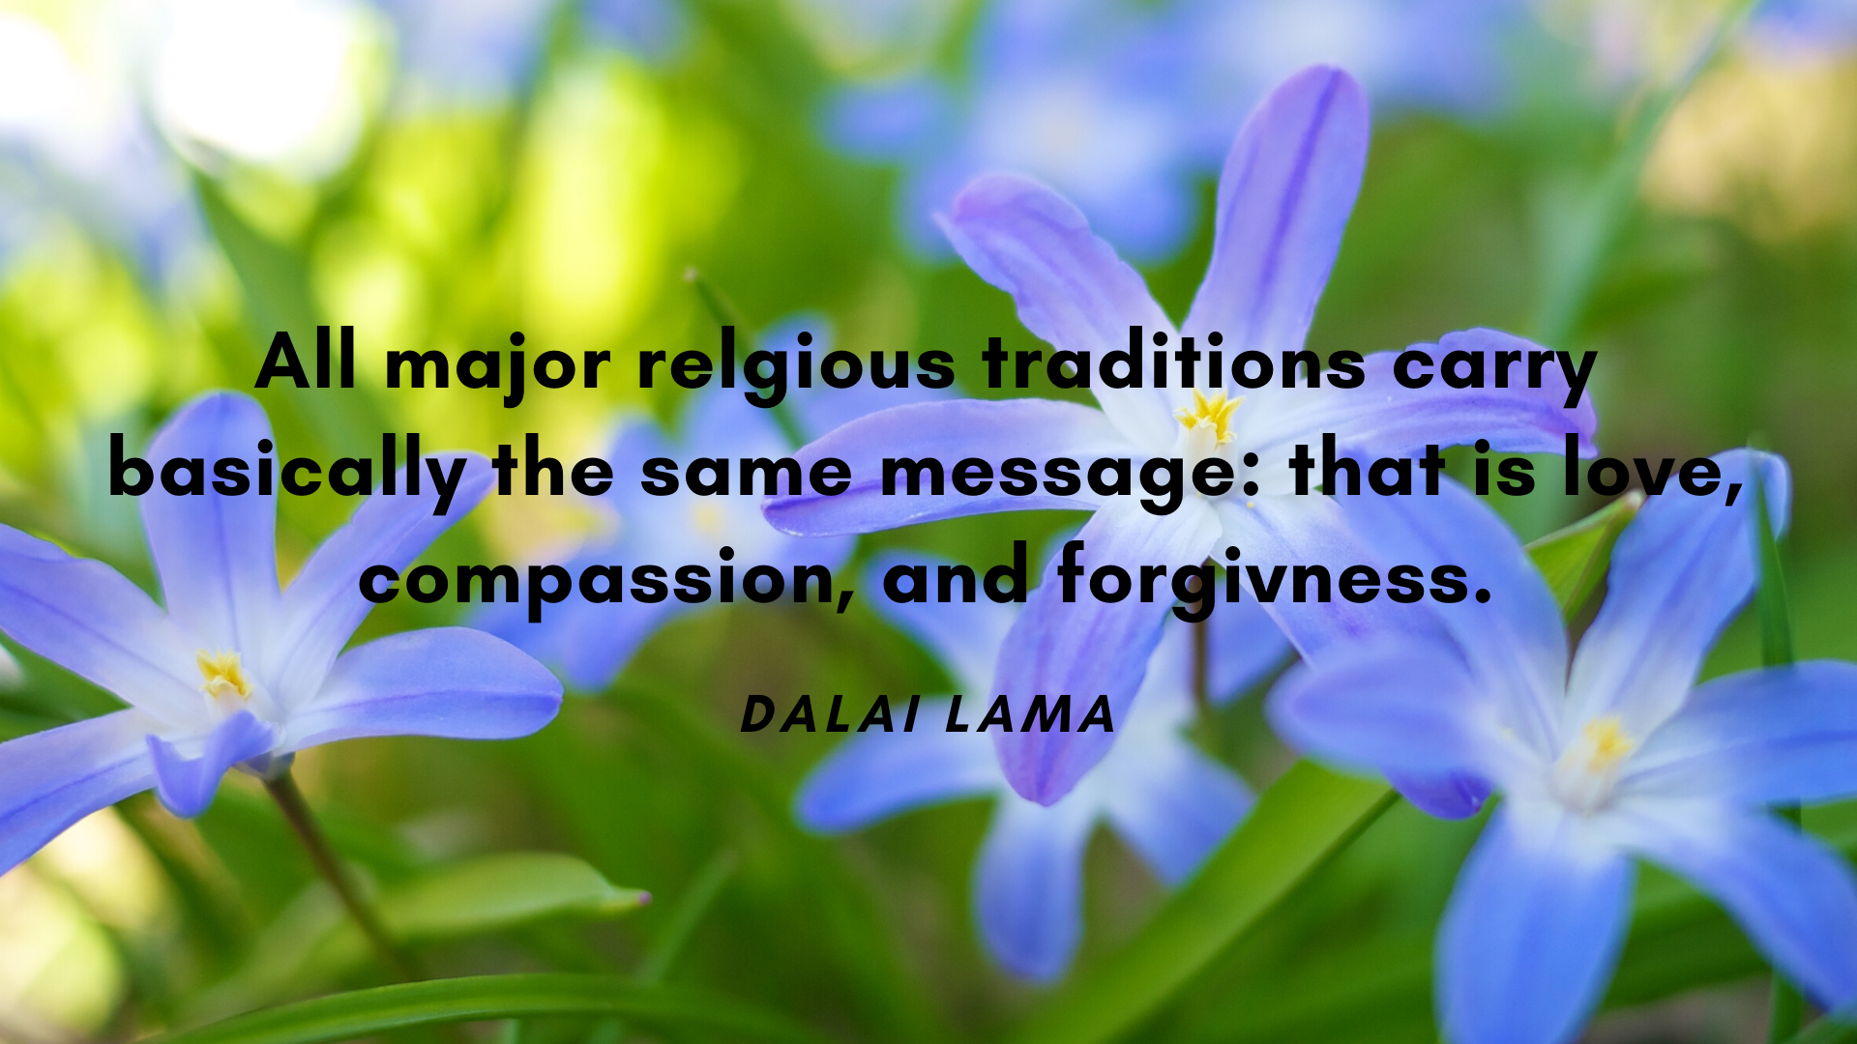
Photo by Ken Whytock - Creative Commons Attribution-NonCommercial License https://www.flickr.com/photos/7815007@N07
Created with Haiku Deck

Slide 24

Making the “Ask”
YOUR VOICE MATTERS!

Slide 25
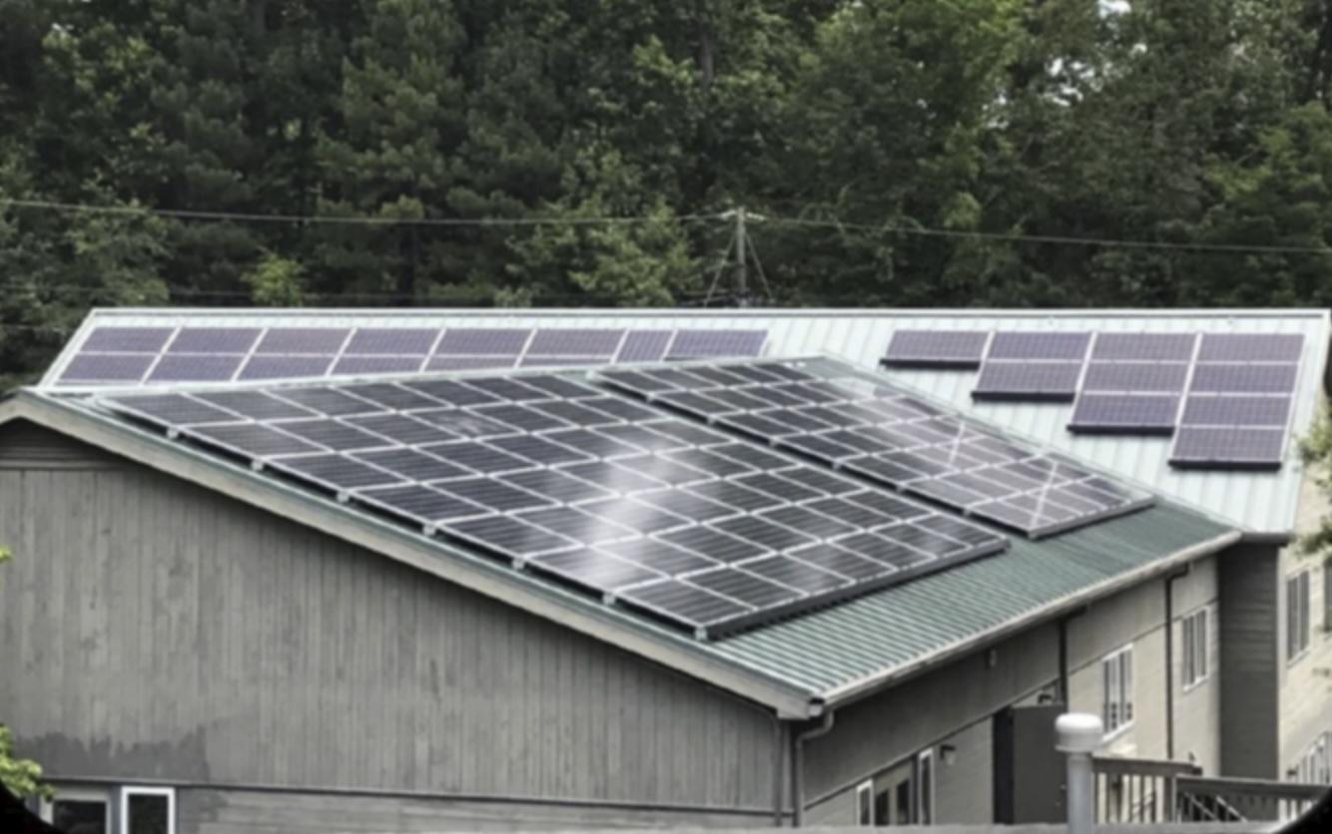
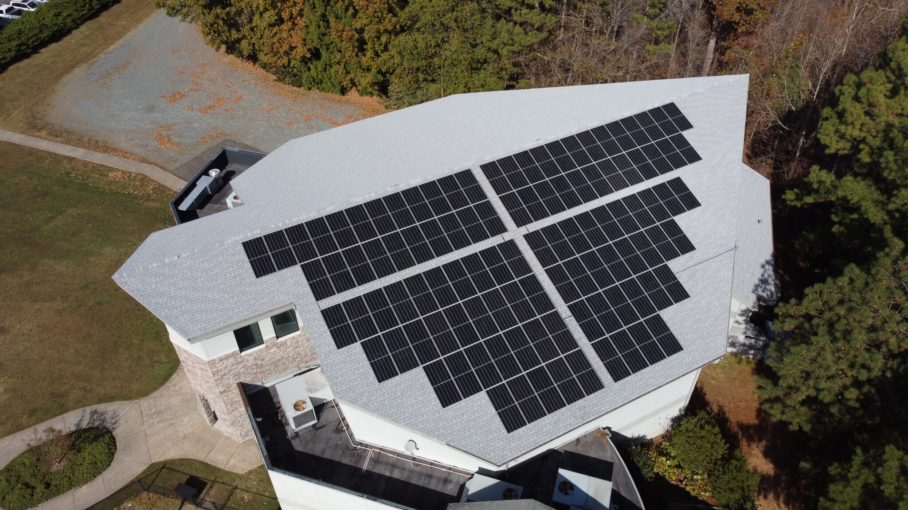
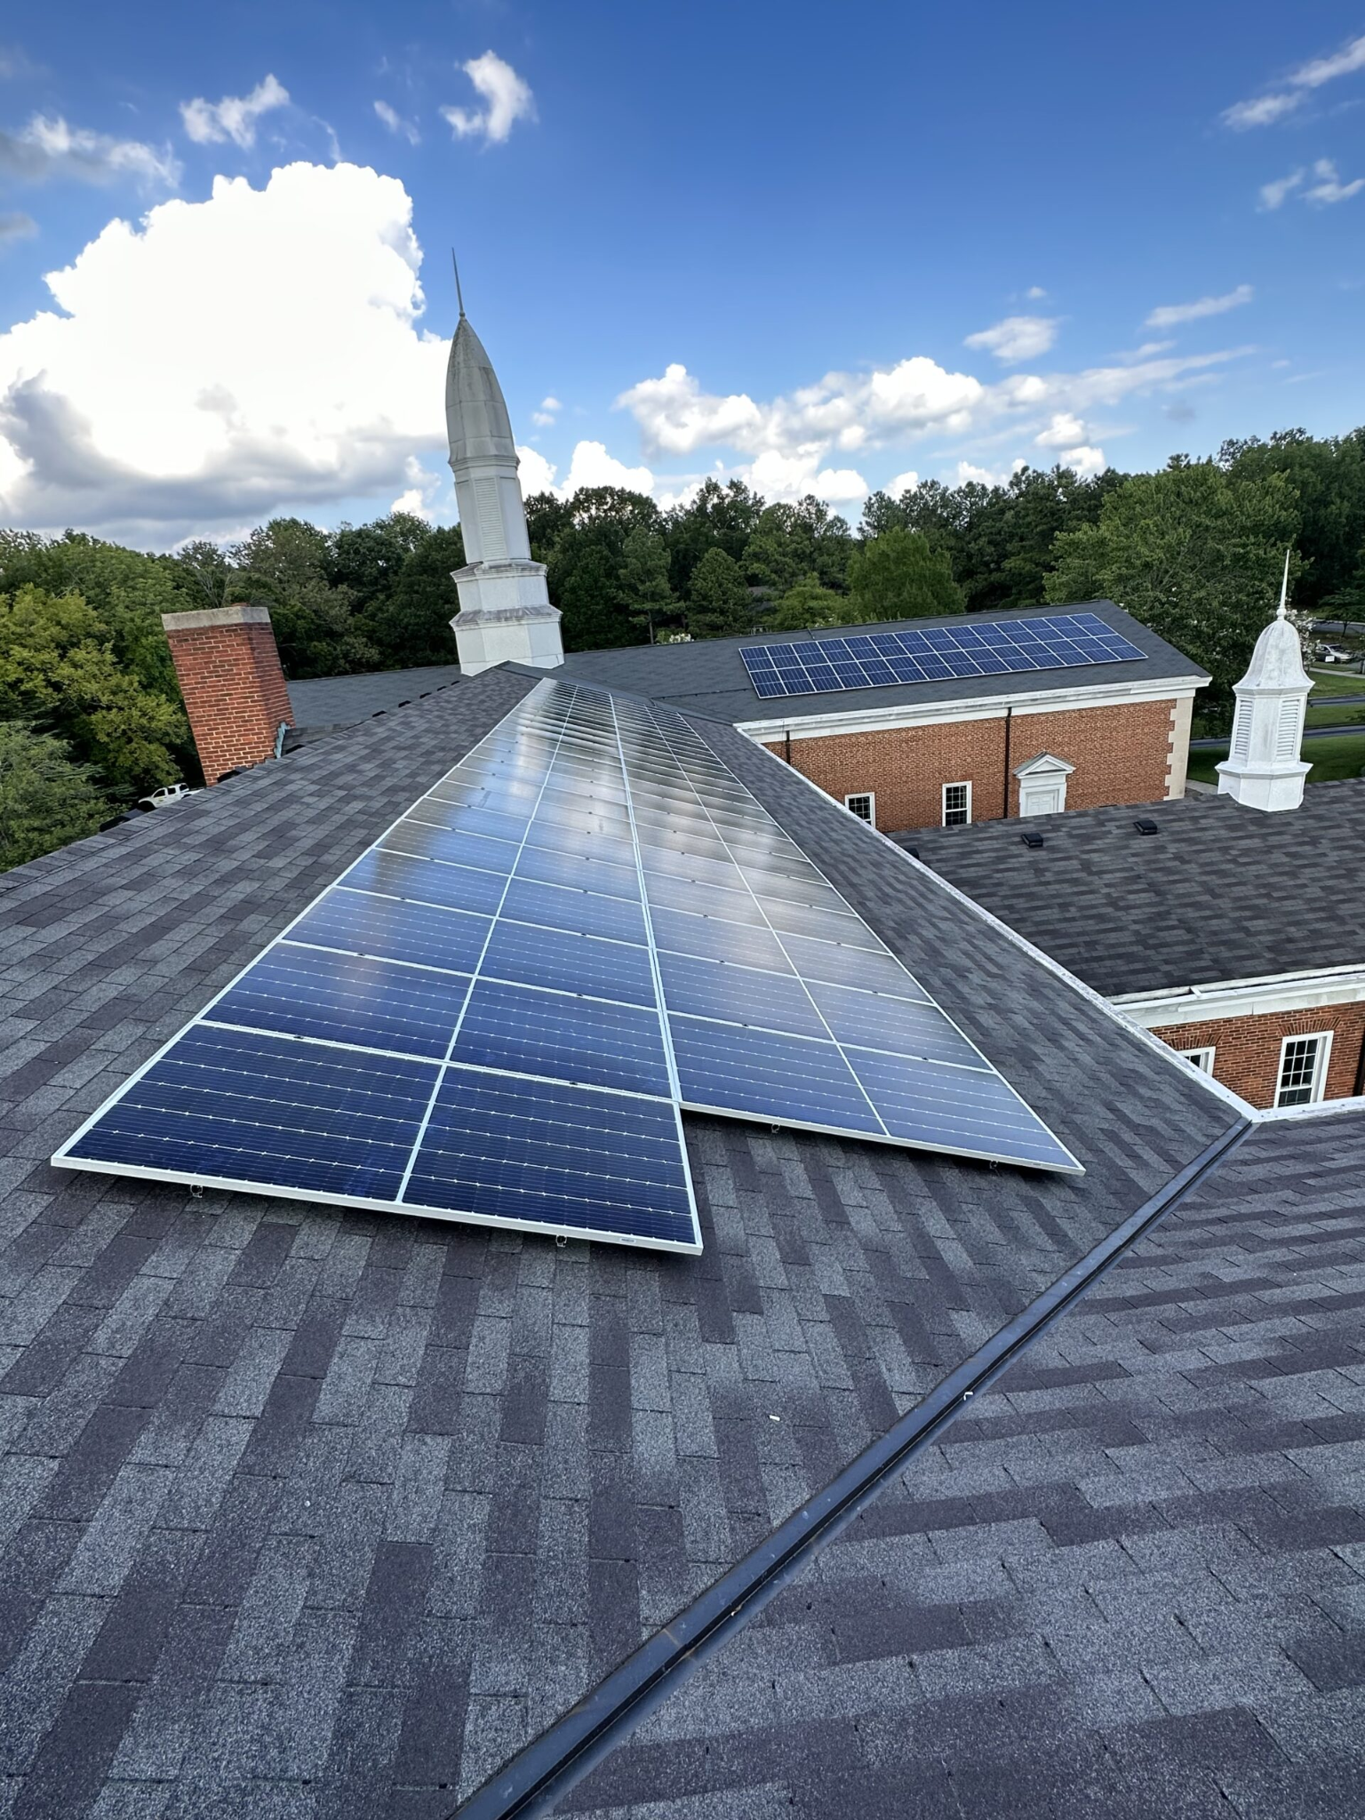
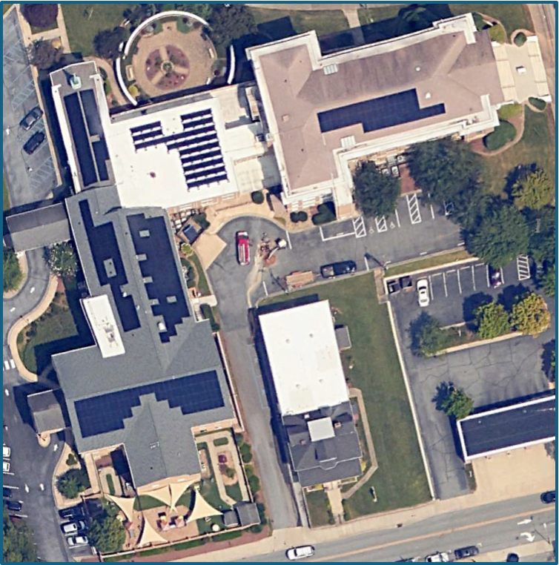

Slide 26
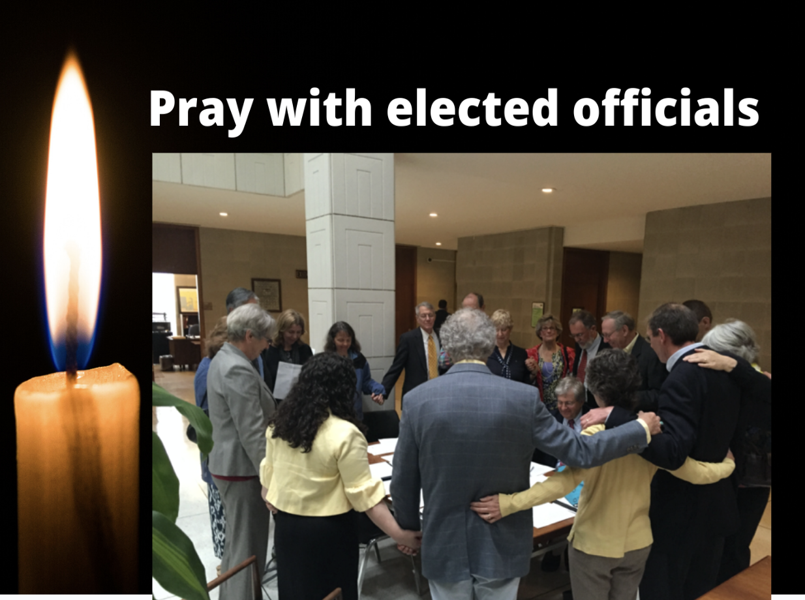

Slide 27
Photo by creepyed - Creative Commons Attribution-NonCommercial-ShareAlike License https://www.flickr.com/photos/32842313@N00
Created with Haiku Deck
Notes:
[SLIDE]

